Slide 1

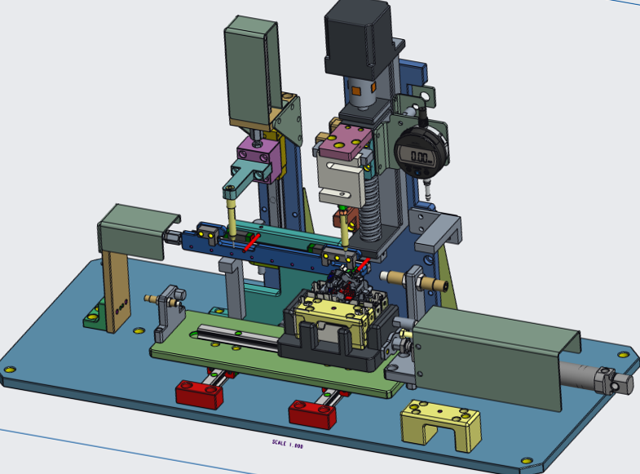
DATE:-08/10/25
TIME:-11:05
MECH.MOUNTING AND TF CHECKING STATION
USER : - SHAIKH GANI
FG CAT NO | TYPE | SERIES | POLE
ABCD123 | AC | AU | 2
AUTO CYCLE RUNNING
SYSTEM READY
MOTOR HOME
PART OK
SCREWING 1 CYCLE
1.POSITION 1 DONE
SCREWING 2 CYCLE
2.POSITION 2 DONE
STROCK COUNTER
50
3.POSITION 3 DONE
LOAD
0.260
gm
MOF OPERATION OK
PART PRESENT
MOF STATION SCAN PART: AURC3204003CZA123000
OK
CYCLE TIME IN SEC
15.2
OK COUNTER
1234
NG COUNTER
1234
RESET
ALARMS: -
///HOMMING SENSOR NG///PART NOT PRESENT///TRIPPED///

Slide 2
DATE:-08/10/25
TIME:-11:05
MECH.MOUNTING AND TF CHECKING STATION
USER : - SHAIKH GANI
SETTING
PLC IP
LOAD CELL COMP PORT
SCANNER 1
192.168.3.21
COMP PORT 4
COMP PORT 5
SCANNER 2
PRINTER IP
COMP PORT 6
192.168.3.22

Slide 3
DATE:-08/10/25
TIME:-11:05
MECH.MOUNTING AND TF CHECKING STATION
PARAMETER
MOTOR PARAMETER
T.F CHECKING PARAMETER
THIS PARAMETER WORK IN BACK GROUND
THIS PARAMETER WORK IN BACK GROUND
SHOW ONLY THIS PARAMETER
SHOW ONLY THIS PARAMETER
LOW LIMIT
HIGH LIMIT
SPEED 1
2000
MIN
MAX
pulses
1000
2000
TRIP FORCE
25
15
40
SPEED 2
300
pulses
300
500
RESET FORCE
250
200
350
SPEED 3
100
pulses
50
100
DISTANCE 1
45.5
40
60
MULTIPLY BY 160
OFFSET
3
-10
+10
mm
DISTANCE 2
5.5
mm
1
5
DISTANCE 3
1.0
mm
0.5
2
MICRO STEP
1
STEP
1
8
STROKE COUNTER
1
15
60
STEP

